Slide 1
Open Source Software Engineering
SE ZG587
Kumar Manish
9th Sept, 2023

Slide 2
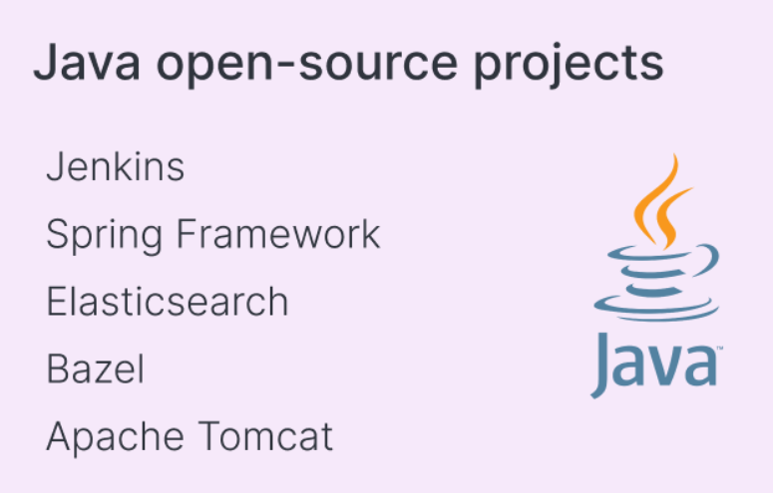
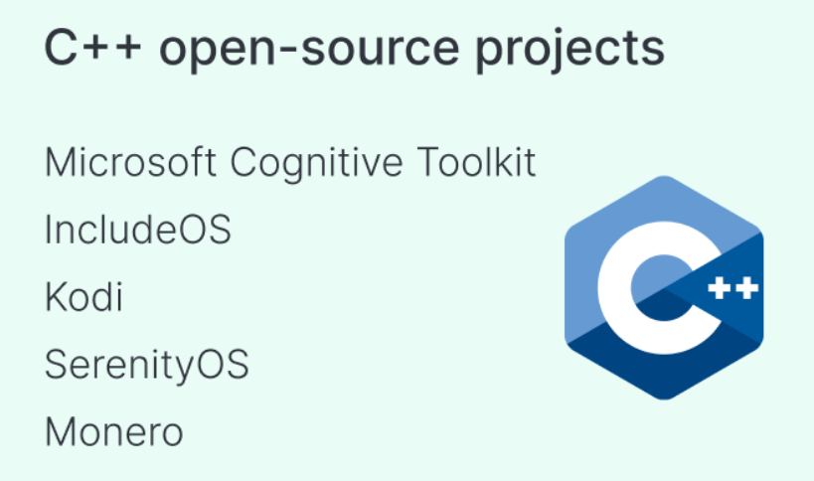
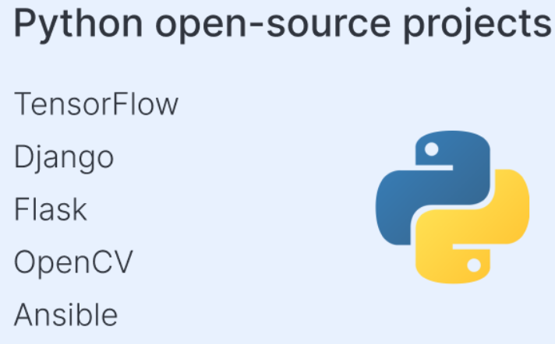
Open source projects
https://opensource.google/
https://opensource.fb.com/projects/
https://www.gimp.org/ : Alternate of Photoshop
https://www.openoffice.org/ alternate of Microsoft office
https://www.alfresco.com/ alternate of Content management

Slide 3
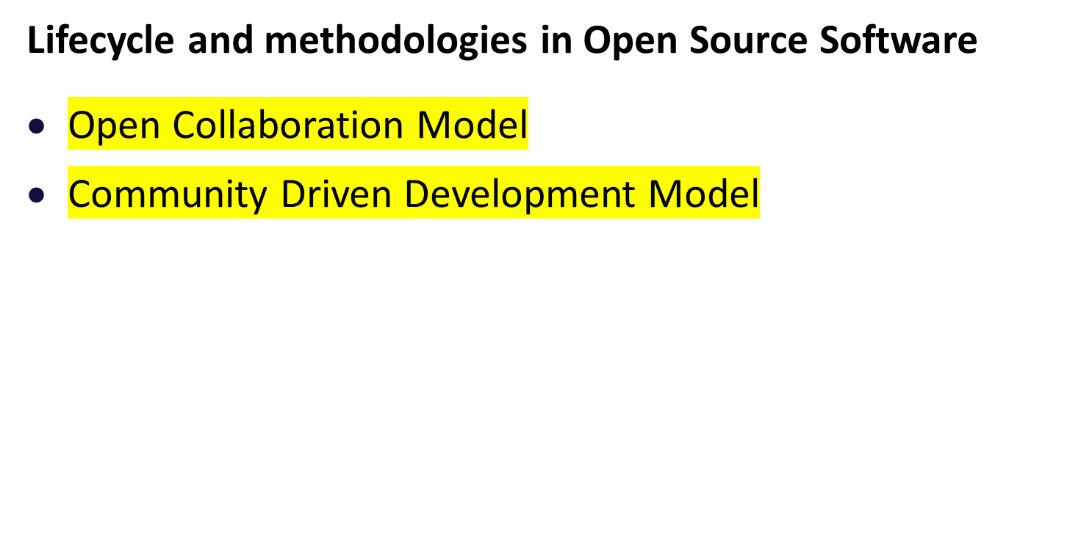
Agenda : Recap

Slide 4
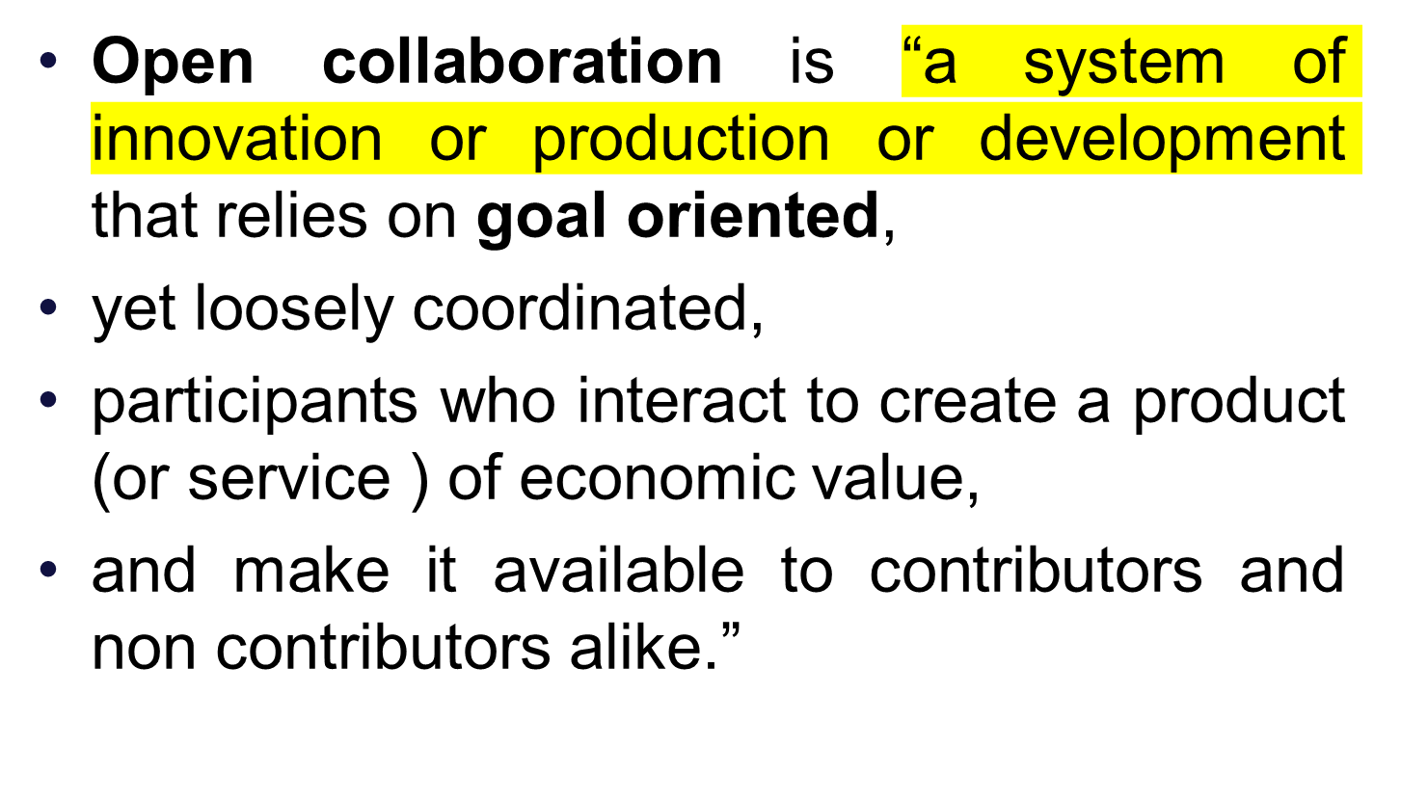
Open Collaboration Model

Slide 5
Open Collaboration Model
: principles
  Equalitarianism :
    To specify that everyone can contribute.
    social equality, prioritizing it for all people.
  Meritocracy :
    To judge contributions, in a transparent manner, based on the merit or the quality of the contribution.
  Self –organization :
    communities organise themselves without any external control or influence from a person or process.

Slide 6
Community Driven Development Model
A group of contributors or developers align their activities together and engage toward the development of open source software
These group of people are often termed as “Community“
A community can also be defined as a group of people
  Which are diverse in nature
  And engage in sharing ideas , work and experiences
  Through a common platform for a common cause
Community comprises of various jobs , roles and multiple sub teams : Developer’s group, Builders group , Testers group Release management group

Slide 7
Community Driven Development Model
Self driven OSS development communities , often provide flexibility to learn members to shuffle between job roles.
These communities are open to customers or end users , inviting them to join the community and contribute to the project
Agile mindset, self motivated, self organised

Slide 8
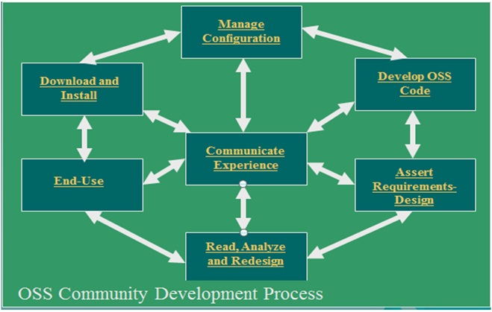
Community Driven Development Process
Requirements & Design
Develop Code
Manage Configuration
Download and Install
End-Use
Communicate Experience
Read, Analyze and Redesign

Slide 9
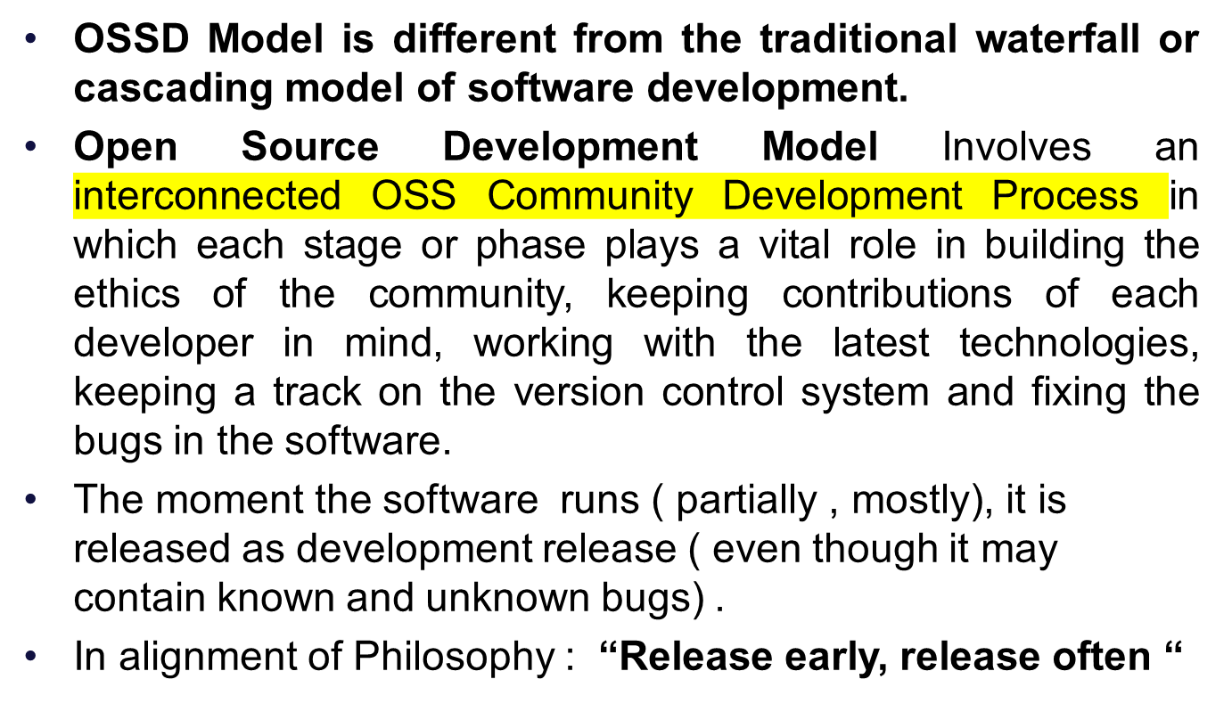
Open Source Software Development Model

Slide 10
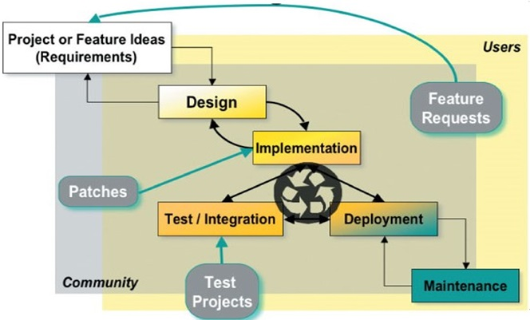
Open Source Software Development Model
Release early, release often
Idea for a new project or new feature or functionality
Design for proposed solution
Implementation by running ( partially or fully)
Development release ( even bug)

Slide 11
Quick check
Can open source software be used for commercial purposes ?
Can I restrict how people use an open source licenses programs ?
Can I call my programs : open source “ even if I don't use an approved licenses ?

Slide 12
Recap :
Open source : Collaboration open and Source freely available
    Freely : Share, Adapt, Modify and Collaborate
OSS : Source code Released under a License in which the copyright holder grants users the rights to use, study, change, and distribute the software and its source code to anyone and for any purpose.
Key Principle of OSS : Openness, Transparency, Collaboration, Expectations of Community
      Release Early and Often : Rapid prototypes and iterative approach
Free software” means software that respects users' freedom and community. It refers to free use of software and not price
OSI : Definitions, Standard Requirements, Licenses
FSF : To promote computer user freedom and defend the rights of all software users
    Richard Stallman in 1983, by launching GNU Project

Slide 13
Recap :
Free software Four essential freedoms
A program is “free software” if its users have the following :
  Freedom 0 : The freedom to run the program as you wish, for an purpose
  Freedom 1 : The freedom to study how the program works , and change it as per your requirements
  Freedom 2 : The freedom to redistribute copies so you can help others
  Freedom 3 : The freedom to distribute copies of your modified versions to others
    Pre-requisite “ Access of the source code”
Legal considerations :
  The owner of the free software does not have power to withdraw or invalidate the license , or add additional restrictions to its terms and conditions,
License terms should be permanent and irrevocable
License must not restrict other software
License must be technology neutral

Slide 14
Recap :
 | Free software | Open source Software | Freeware | Public domain software
Definition | “FREE” is a matter of liberty , not price | “OPEN” does not just mean access to the source code; more about collaboration | Free refers to price , while freedom of the use is restricted by creator | PUBLIC domain belongs to the public as a whole
Philosophy | Social movement | Development methodology | Marketing goals | Copyright disclamation
Rules | Four freedoms | Open source Initiatives |  | Creative common Org
Free of charge | Not necessary | Not Necessary | YES | YES
Copyright law | YES | YES | YES | NO
Examples | Linux, Ubuntu , MySQL, Apache | Linux, Ubuntu , MySQL, Apache | Skype, Adobe acrobat | SQLite

Slide 15
Recap :
Understanding Intellectual property Rights (IPR) to the software industry
  Patents – used to protect functional features , like hardware configurations etc
  Copyrights – used to protect works of authorship, like source code , diagram etc
  Trade secrets – used to protect internal business secrets, like business and pricing models
  Trademarks - used to protect brand recognition, through logo etc
All the people involved in a development project, may claim for the ownership of the IPR for the various artefacts developed as a part of the project.
Understanding Software Licenses
  Licensing Models in OSS:
        Copyright, Copyleft, Permissive, Creative Commons

Slide 16
Recap :
Copyleft or Protective Licensing Model :
To make a work ( or program ) free to use, modify , adapt or extend.
Aligned with the four essential freedoms
No re-licensing allowed, No commercial usage allowed
All modified and extended version of the work ) or program ) should be free as well - hence called protective licenses
All derivative works should be attributed to the creator, open sourced and copyleft
Variants of Copyleft : Strong and Weak copyleft :
The strength of the copyleft license is decided based on the extent its provision are imposed on the derived works
Most commonly, weak copyleft licenses are used to create Software libraries
Help software to link to the library and redistributed without requirement for the linking software to also be copyleft –licensed
Examples :
  Strong Copyleft :
    GNU general public License
  Weak copyleft
    GNU lesser General Public License –
    Mozilla public license

Slide 17
Recap
Permissive Licenses
Free software licenses with only minimal restrictions on how the software can be used , modified and redistributed ( also called Berkeley software distribution : BSD - like or style licenses )
Rules for usage - what ever user wants, but with few restrictions – derived works must be attributed to the creator
Source code need not be open or made available in the public domain
Re-licensing allowed - derivative works can be release under any other licenses or used as proprietary products
Allows commercial usage
Examples : GNU All permissive License, MIT License, BSD licenses, Apple Public source licenses. Apache license

Slide 18
Recap
Copy left (Protective Licenses ) | Permissive Licenses
Publication of software code of all modified versions or derived works under the original copyleft licenses / protective licenses | Provides No guarantee that derived works of the software will remain free and publicly available ; generally requiring only that the original copyrights notice be remained
 | Hence derived works , or future versions , of permissively – licenses software can be released as proprietary software Permissive licenses offer highly extensive license compatibility as compared to copyleft licenses Wider adaptability in the open source community

Slide 19
Recap
Choosing Open Source Licensing Models : Based on Permissions, Distribution, Modification, Use.
Option 1: Work with a community –
  Contributors License Agreement (CLA)
    Simple CLAs vs Detailed CLAs
    Individual CLAs vs Corporate CLAs
Option 2: Keep it simple and permissive - Choose the MIT License ,
Option 3: Need to share improvements
Option 4: Work without a license
Why to choose Open Source Licensing Models?
To protect works contributed in the open source domain
To protect contributors and users from any copyright infringements
To Interested developers or contributors or business will not touch a project without a license protection.

Slide 20
Recap
Open Source Business Model
1. By Intellectual Property :
- Dual Licensing Model –
  Community version – under GPL
  Enterprise version – under commercial license
- Open Core Model : Core portion of the software, which provides the basic functionality is made available as open source
2. By Services and other Business model
  Open source SaaS model – example WordPress, Sharetribe...
  Selling services : such as consulting service , technical support service, or training
  Donation, Users advertisement, and Merchandise
  Crowd Funding and Crowd Sourcing
  Freemium Business Model - Feature limited - basic Features vs. Extended features Time limited – fixed duration after that paid versions

Slide 21
References and further readings
Free software foundations https://www.fsf.org/
GNU https://www.gnu.org/
Open Source Initiative https://opensource.org/
Open Source Resources https://opensource.com/
Open Source Guides https://opensource.guide/
Creative commons https://creativecommons.org
Choose a license https://choosealicense.com/
Copyleft https://copyleft.org/

Slide 22
References and Recommended Reading:
How Developers Can Make money with Open Source Projects
https://rubygarage.org/blog/how-make-money-with-open-source-projects
What Motivates a Developer to Contribute to Open-Source Software?
https://clearcode.cc/blog/why-developers-contribute-open-source-software/
How do Open Source Programmers make money
https://www.thewindowsclub.com/open-source-companies-programmers-make-money
https://en.wikipedia.org/wiki/Business_models_for_open-source_software
Bounty Source https://bountysource.com/ for Cloud Funding
Gunio https://gun.io/

